Slide 1
TankInATank
09/27/2017-Iteration 0
Team 1 - Postponer
Linlan Chen, Shuhan Liu, Haotian Wu,
Baoxiang Yang, Lei Yang, Qiwei Zheng

Slide 2
Overview
Related Work
Requirement
Management Plan
Quality Assurance
Configuration
Topic Today

Slide 3
Overview
2.5D local multiplayer tank fighting game in Unity3D
The video game industry has been continuously growing since the beginning of the twenty-first century. In recent years, with the development of GPU design, computer graphics algorithms, and virtual reality, the potential has been unleashed.

Slide 4



Motivation
Indie Games: An independent video game (commonly referred to as an indie game) is a videogame that is often created without the financial support of a publisher.
Notes:
Self funded. A lot of small companies and groups are making more and more indie games. Some of them are aiming to success and some of them are just showing off of skill. None of us has experience in game developing so we think it will be a good practice to develop a small game. Simple, small and have a unique style.

Slide 5

Project
Local Multiplayer Games: Games can be played by multiple users on a singular device
Family party
LAN party
Notes:
Due to the length of the project. It will be impossible for us to implement a complicated online multiplayer game. So we decided to build a the local multiplayer games. It is a good game mode for a family party that people can sit down shoulder to shoulder and enjoy the game. Also this kind of game brings back of the memory of LAN we will implement online multiplayer feature in later iteration. We will introduce our detailed requirement shortly.

Slide 6
Related Work
Tank Games:
Tank Destroyer
Hogs of War
World of Tanks
ToonTank
S.W.I.N.E.
Local Multiplayer Game:
Gang Beast
Rocket League
Portal
Notes:
There are countless tank fighting games that you can find on steam or other gaming website, however, as stated above. There is no recent keyboard-controlled 2.5D tank fighting game that has offline multiplayer mode. Most of the related 2.5D tank game were made more than a decade ago.

Slide 7
Requirement - Functional Requirements
Essential Features:
Start game with another player on the same screen.
Pause, restart or quit the game during the game.
Choose a tank.
Choose one map out of three.
Let system randomly choose one map.
Let the tank move left, right, up or down.
Let the tank shoot shell and if a shell hits a tank, tank will lose HP..
Tank has HP and game will be over if one tank loses all HP.
Tank will have areas(mountains, etc) where cannot move through.

Slide 8
Requirement - Functional Requirements
Desirable Features:
Choose different types of tank.
Use items to recover HP, increase attack or speed up.
Can destroy small objects(walls, hills, etc) on the map by shooting shell and when those objects on the map are destroyed, items will be randomly dropped.
Have more than 5 maps to choose.

Slide 9
Requirement - Functional Requirements
Optional Features:
Can let system generate a map randomly.
Can play the game alone.
Can play the game with other players online.
When playing the game alone, computer will control another tank. AI will be designed.
Can play with a specified player when playing the game online.

Slide 10
Requirement - Nonfunctional Requirements
Scalable back-end design.
Smooth game experience.
Nice game art design and UI design.
Detailed game instructions.

Slide 11
Management Plan - Process Model
Roles:
Product Manager: 1
Developers: 6
Testers: 3
Documents: 2
Q & A: 1
Configuration Settings: 2
Team Communications:
Weekly Meeting
Monday’s work from home
Team Assess
Writing peer reviews at midpoint and final

Slide 12
Management Plan - Objectives & Priorities
Basic Goal:
Finish Basic tank game function with a basic map and manipulate by keyboard input
Stretch Goal:
Map-Select function
Tank-skills function
Online Mode
Multiplayers Mode
Potential Tasks:
Priorities would mainly based on time. Task near its deadline would get high priorities.
Functional tasks would generally have higher priorities than documentations tasks

Slide 13
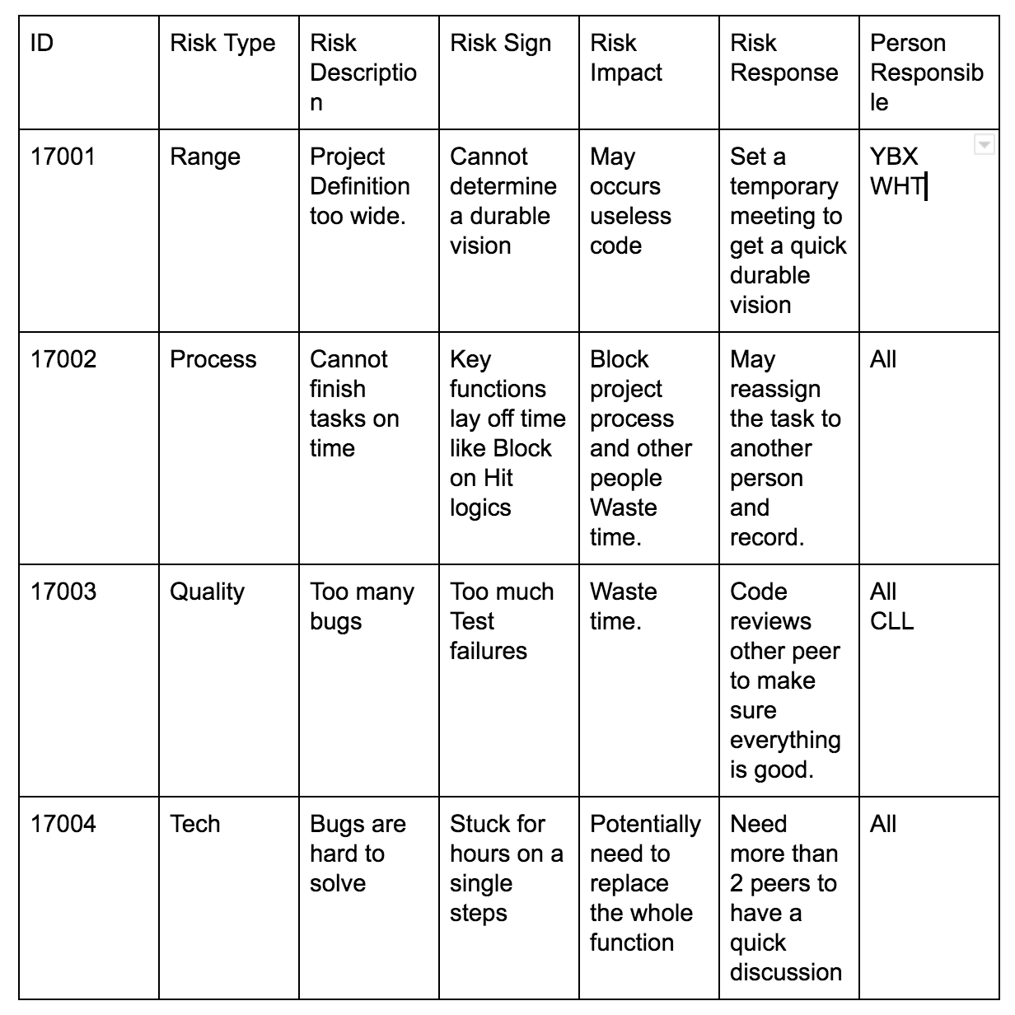
Management Plan - Risk Management
ID
Risk Type
Risk Description
Risk Sign
Risk Impact
Risk Response
Person Responsible

Slide 14
Management Plan - Tools & Schedule
Tools:
Google Docs, Google Drive;
Github; Pivotal Tracker;
Slack;
Schedule:
Iteration 0: SPPP & Role management (finish)
Iteration 1: Configuration Setting & Basic Map Design & Game Logic
Iteration 2: 11/08
Iteration 3: 12/06

Slide 15
Quality Assurance Plan - Metrics
Stability Metrics 1: Number of defects existed in module (Stability) Metrics 2: Code lines to test cases (Stability) Metrics 3: Test coverage (Stability)
Complexity Metrics 4: Number of classes (Complexity) Metrics 5: Code lines (Complexity) Metrics 6: Number of files (Complexity)
Workload Metrics 7: Number of working hours per week per person (Workload) Metrics 8: Number of code lines per person (Workload)

Slide 16
Quality Assurance Plan - Standard
Documentation standard - clear and accurate Design documents, quality assurance documents, requirement documents
Coding standard - stable and reusable <How to write testable code> Code review

Slide 17
Quality Assurance Plan - Review Process
Code Review Time: Each code commit Who: Programmers How: Online dialogs
Document Review Time: End of iteration Who: All How: Face-to-face discussion
Requirement Review Time: Begin of iteration (Except iteration 0) Who: All How: Face-to-face discussion

Slide 18
Quality Assurance Plan
Testing
Types of Testing:
Functional Testing - Make sure general functions works properly.
Boundary Value Testing - As a game, bugs always occur at boundary values.
Beta Testing - Release beta version for teammates to play.
Testers: For first two, we have a tester. To do the beta testing, all people will engage.
Test cycle: Every Iteration after iteration one, when general functions are ready.

Slide 19
Quality Assurance Plan
Defect Management
Criteria: priority of a defect would indicate the urgency with which it would need to be fixed. Justice of the game (High Priority) - Like calculating health bars, attack damage etc.
To manage defects, we will start on problems with high severity to low severity. Each problem will be posted to every teammate.
Tools: Trello, PivotTracker

Slide 20

Configuration Management Plan
IDE: Unity 2017.1.1
Version Control: Git
https://github.com/LinlanGrace/MET-673-Team-1
Branches:
Development Branch : under development
Master Branch: produc version
Feature Branch: feel free to add feature branches for single features

Slide 21
Configuration Management Plan
Code Commit Guidelines:
Pull from mainline first and resolve the conflicts before any changes.
Code should be committed with clear documentation.
Code review is required before a commit.
Inform others if you want to touch their feature branches.
Remember to $git push to publish your work.

Slide 22
Thank You
09/27/2017
Team 1 - Postponer
Linlan Chen, Shuhan Liu, Haotian Wu,
Baoxiang Yang, Lei Yang, Qiwei Zheng

